Slide 1

face mask detection system
Mentor- SUBMITTED BY-
dr. Abhilasha Sharma SHUBHAM DHIMAN(201372)
Group no.-03 PRIYANSH AGARWAL(201480)
PUNEET KATOCH(201385)

Slide 2
INTRODUCTION
In the wake of the novel coronavirus, lots of disciplinary actions are imposed by the government of many countries to slow down the transmission of the deadly virus.
With the enhancing usage of modern technology in the period of pandemics to smoothen up the operations and functionality of the numerous organizations.
Among these, with the interpretation of AI, facemask detection technology is used to monitor social distancing and even to identify the usage of face masks.
Face mask detection is used to detect whether a person is wearing a mask or not.
In fact, the problem is reverse engineering of face detection where the face is detected using different machine learning algorithms for the purpose of security, authentication and surveillance.

Slide 3
LITERATURE REVIEW
Reference No. | Problem | Methodology | Dataset | Work Done | Accuracy
[1] | FACE MASK DETECTION USING YOLOV5 | FACE MASK DETECTION USING DEEP LEARNING | PUBLIC DOMAIN | USED YOLOV5 PRETRAINED MODEL FOR IDENTIFYING A PERSON HAS WEAR MASK OR NOT. | ACCURACY OBTAINED= =93.4%
[2] | FACE MASK DETECTION USING DEEP LEARNING | DEEP LEARNING | PUBLIC DOMAIN | USED DEEP LEARNING TO IDNTIFY MASK WEARING PEOPLES. | ACCURACY OBTAINED= 98.7%
[3] | FACE MASK DETECTION USING COMPUTER VISION | COMPUTER VISION | PUBLIC DOMAIN | USED COMPUTER VISION WITH OPENCV, AND TENSORFLOW. | ACCURACY OBTAINED= =81.93%

Slide 4
Reference No. | Problem | Methodology | Dataset | Work Done | Accuracy
[4] | ACHIEVING HIGH ACCURACY USING CONVOLUTIONAL NEURAL NETWORK. | CNN ARCHITECTURE. | PUBLIC DOMAIN | USED CNN TO IDNTIFY MASK WEARING PEOPLES. | ACCURACY OBTAINED= 93.89%
[5] | MULTICLASSMASK CLASSIFICATION WITH A NEW CONVOLUTIONAL NEURAL MODEL. | CONVOLUTIONAL NEURAL MODEL. | PUBLIC DOMAIN | USED CNN TO IDNTIFY MASK WEARING PEOPLES. | ACCURACY OBTAINED= 97.65%

Slide 5
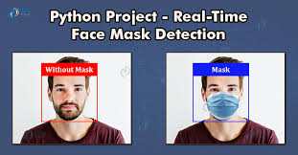
PROBLEM STATEMENT
The goal of our project is :
To design a face mask detection system that can accurately identify whether a person is wearing a mask or not in real-time.

Slide 6
OBJECTIVES
To perform state of art analysis for different studies conducted for face mask detection using machine learning.
To analyze the different parameters essential for face mask recognition and detection system.
To design an accurate and efficient real-time automated face mask detection system to detect whether a person is wearing a mask or not.
To generate alerts and notifications to relevant personnel when a person is detected without a mask.

Slide 7
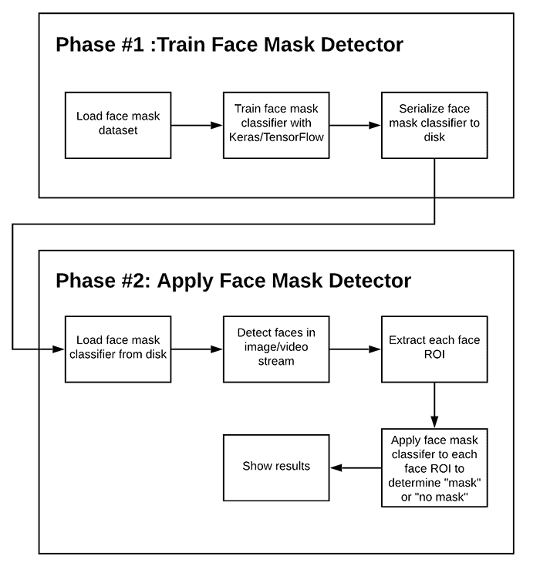
PROJECT DESIGN

Slide 8
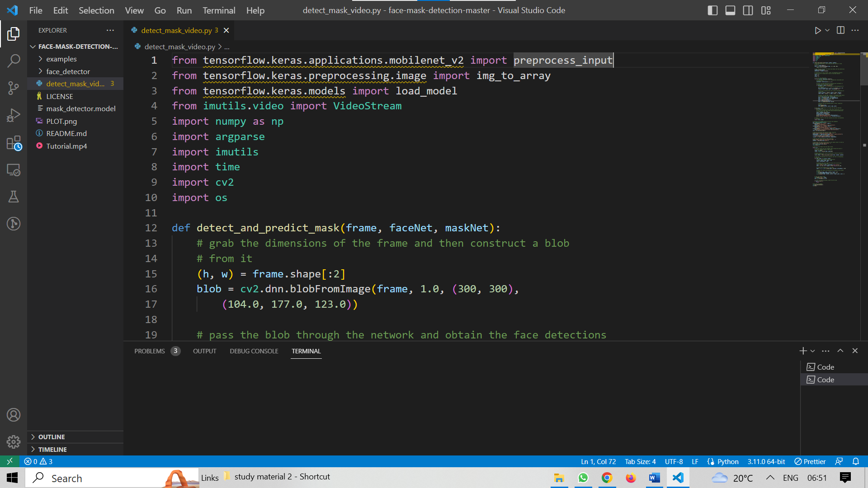
Screen shots of the various stages of the Project(For live detection)-

Slide 9
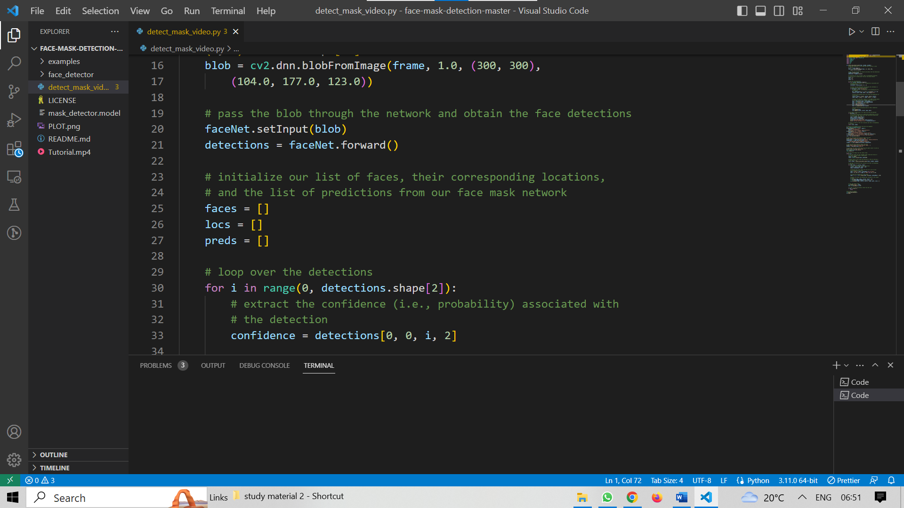

Slide 10
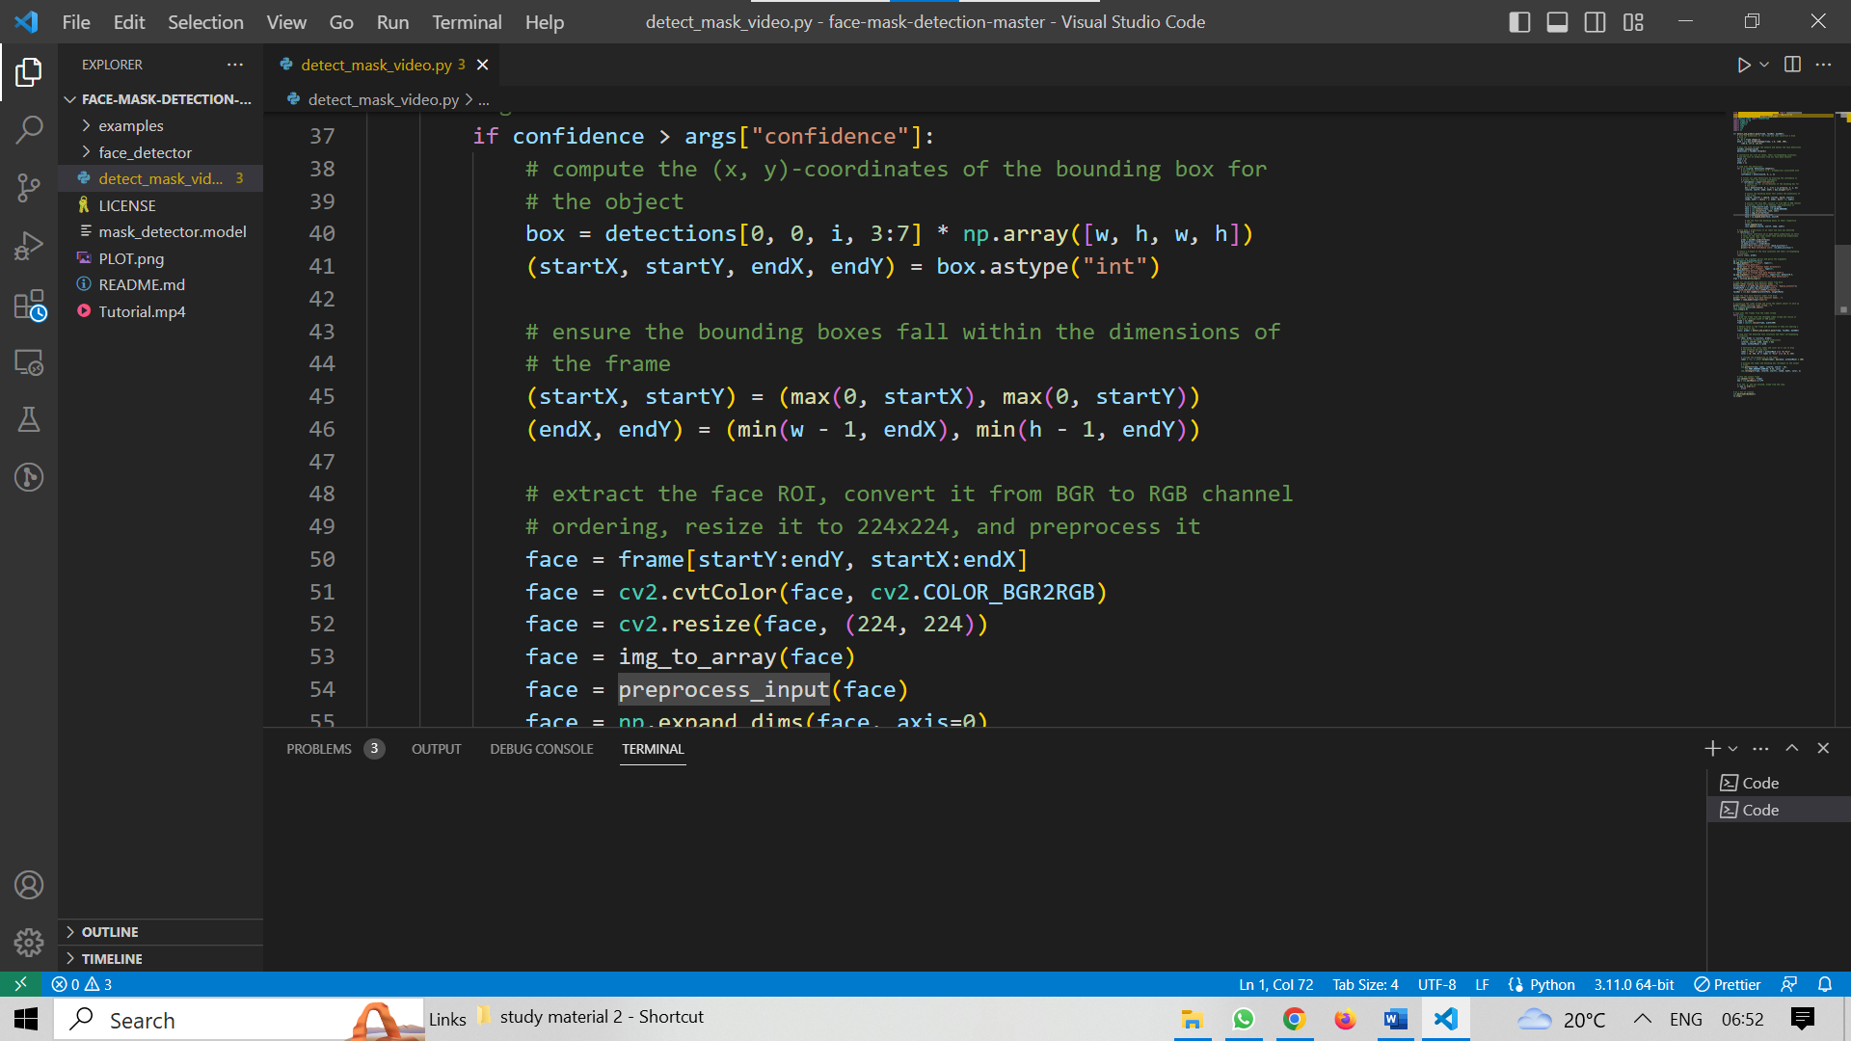

Slide 11
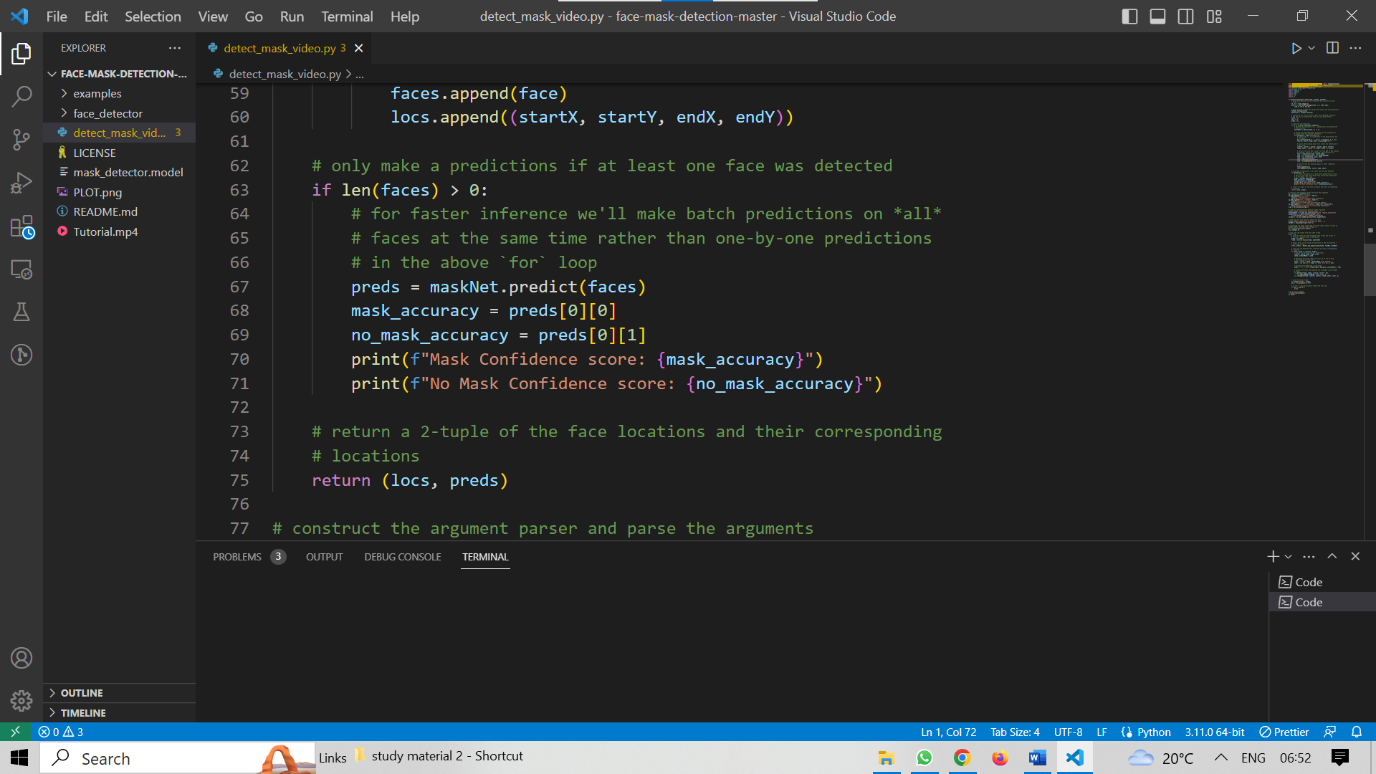

Slide 12
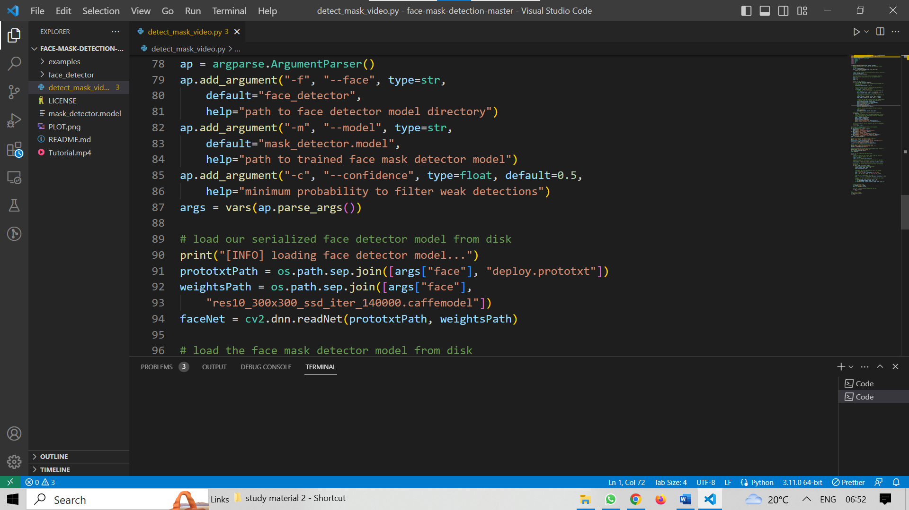

Slide 13
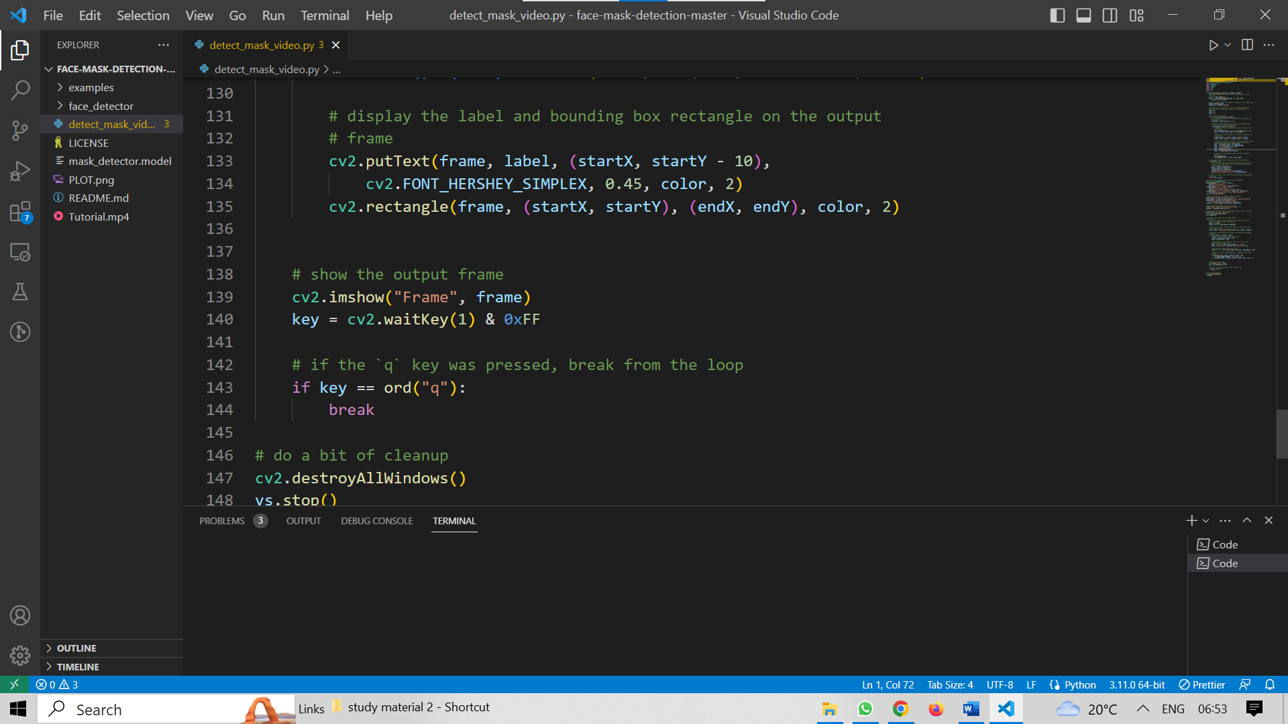

Slide 14
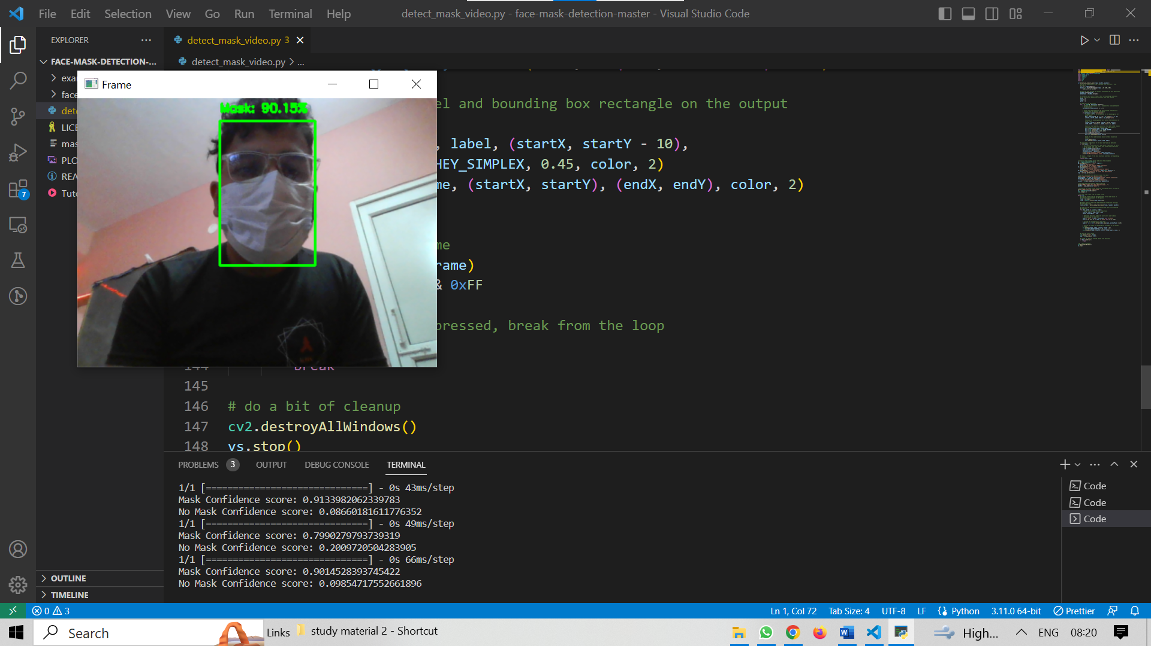
OUTPUT-(WITH MASK)-

Slide 15
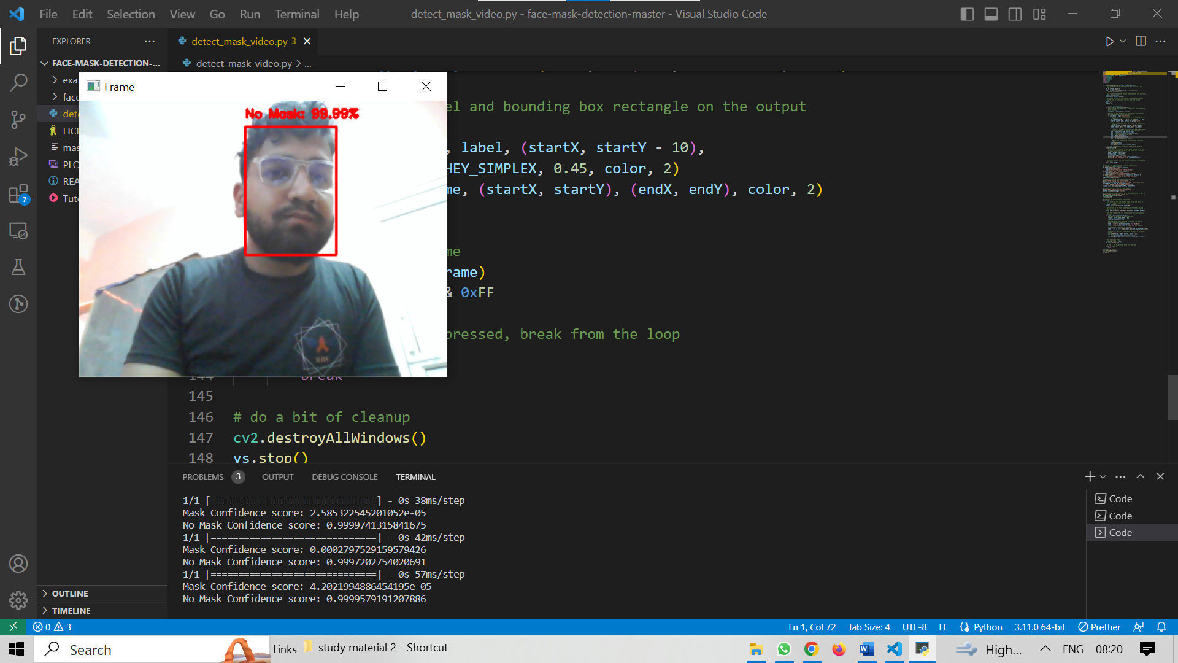
(WITHOUT MASK)-

Slide 16
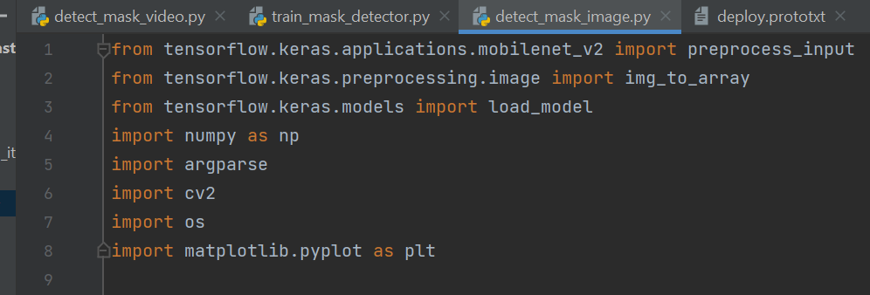
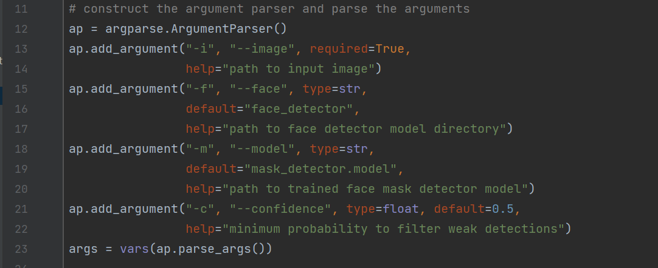
Screen shots of the various stages of the Project(For live detection)-

Slide 17
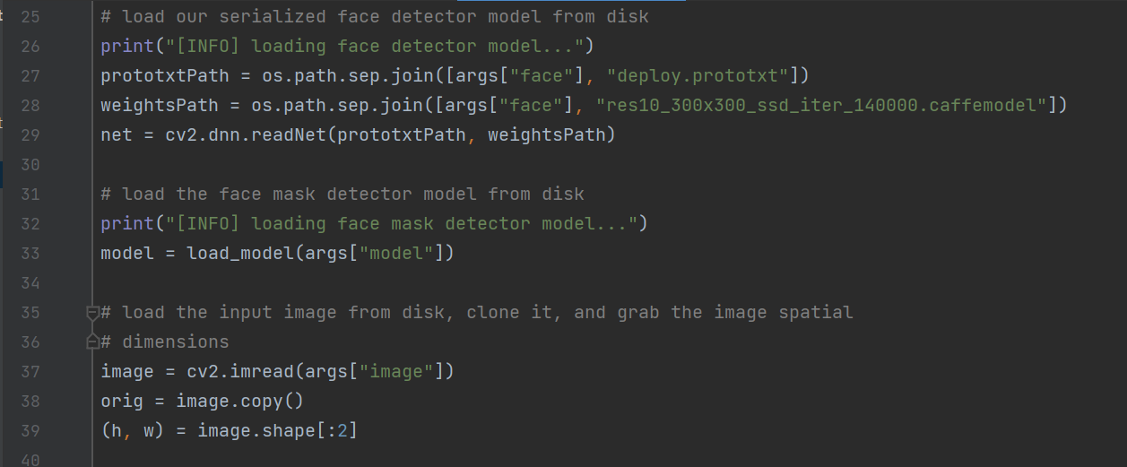
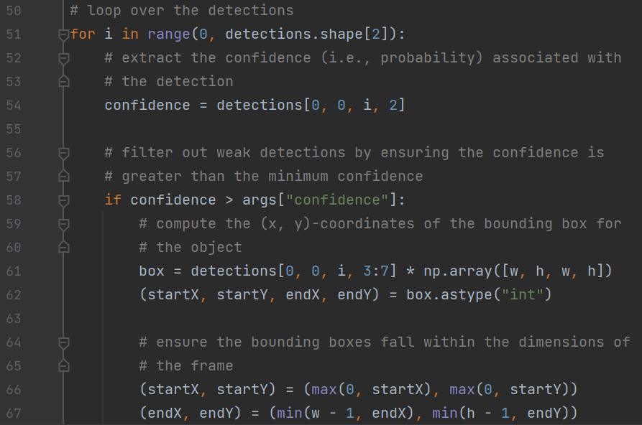

Slide 18
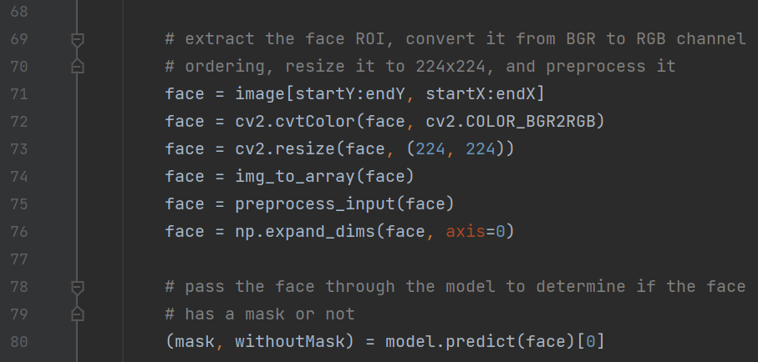
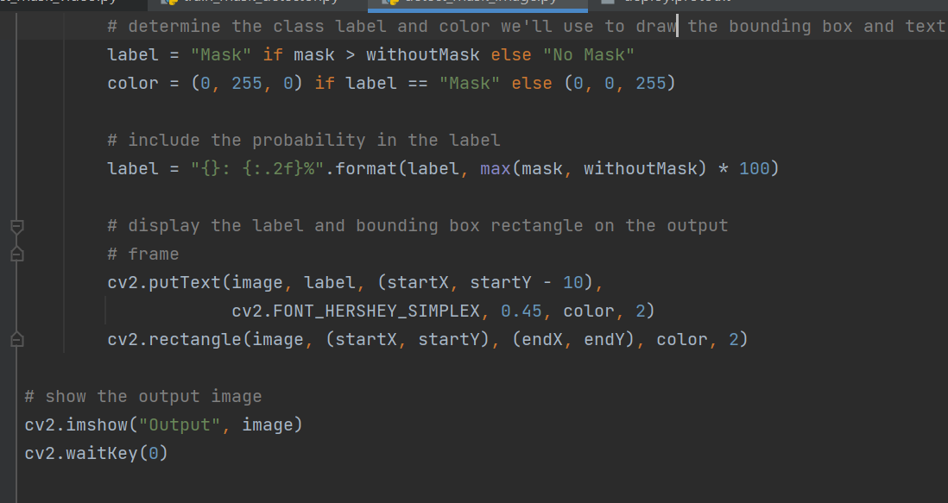

Slide 19
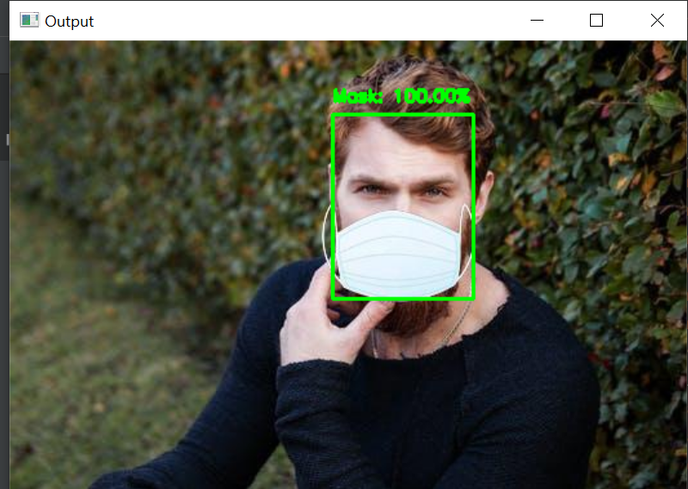
OUTPUT-

Slide 20
CONCLUSION-
Measures must be taken to control the spread of the COVID19 pandemic. This face mask recognition system is a very good and efficient way to do so.
The system will separate the people from the crowd who are not wearing mask.
The identification of people, violating the COVID norms increases the adaptability of the face mask detection system for the public sake.
The system can be applied in many areas like metro stations, markets, schools, railway stations and many other crowded places to monitor the crowd and to ensure that everyone is wearing mask.

Slide 21
FUTURE SCOPE
The proposed system could be upgraded for future works by integrating them with automated thermal detection systems.
A feature of facial landmark detection could be added for biometric purposes.
The quality of datasets could be improved by removing images with insufficient light.

Slide 22
REFERENCES
[1] Ieamsaard, Jirarat, Surapon Nathanael Charoensook, and Suchart Yammen. "Deep learning-based face mask detection using yolov5." 2021 9th International Electrical Engineering Congress (iEECON). IEEE, 2021.
[2] N. Sharma, R. Sharma, N. Jindal, Machine learning and deep learning applications-a vision, Global Trans. Proc.
[3] Liu, S., Qi, L., Qin, H., Shi, J., & Jia, J. (2018). Using a network for instance segmentation. In Proceedings of the IEEE conference on computer vision.
[4] Z. Zhang, B. Bowes, The future of artificial intelligence (AI) and machine learning (ML) in landscape design: a case study in coastal Virginia, USA, J. Digital Landscape Arch. 2019 (4) (2019).
[5] Nishiura, H., Kobayashi, T., Miyama, T., Suzuki, A., Jung, S. M., Hayashi, K., ... & Linton, N. M. (2020). Estimation of the asymptomatic ratio of novel coronavirus infections (COVID-19). International Journal of infectious diseases, 94, 154.

